Slide 1



Recommender System
Special Crafted by
Akbar Maulana

Slide 2



Trainer Bio
Experience :
Data Scientist at Jabar Digital Service
Data Science Tutor at Shift Academy
Business Intelligence Analyst at Jabar Digital Service
Owner and Consultant at Barz Data Consultant
Data Scientist at IYKRA
Data Analyst at BAPPEDA Sukoharjo
Data Analyst at PT. Arah Environmental
www.linkedin.com/in/akbar-maulana/
akbar.maulana2298@gmail.com

Slide 3
After this class, you will be able to
Understand different types of Recommender System
Create a recommender system using content based and collaborative filtering

Slide 4
What is Recommender system?
Recommender System is a system that seeks to predict or filter preferences according to the user’s choices. Recommender systems are utilized in a variety of areas including movies, music, news, books, research articles, search queries, social tags, and products in general.
Like many machine learning techniques, a recommender system makes prediction based on users’ historical behaviors. Specifically, it’s to predict user preference for a set of items based on past experience. To build a recommender system, the most two popular approaches are Content-based and Collaborative Filtering.

Slide 5
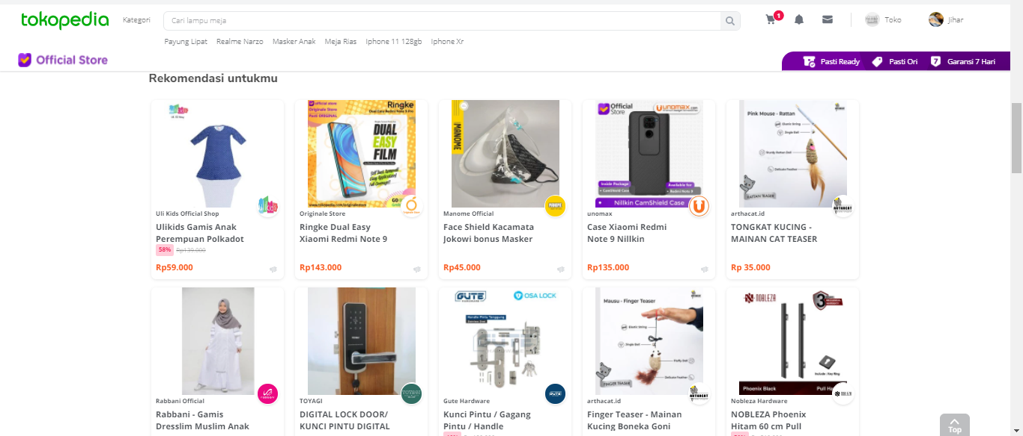
Recommender System Around Us

Slide 6
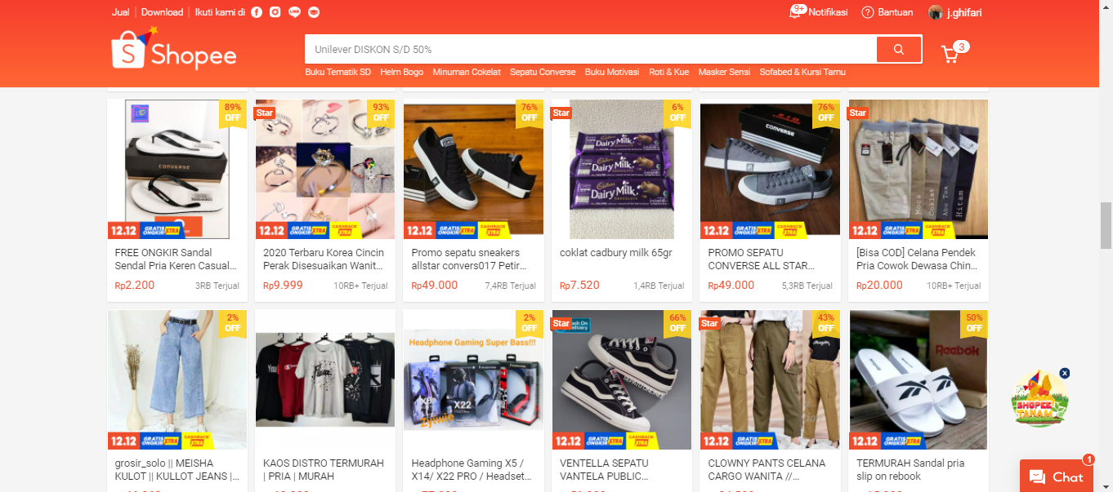
Recommender System Around Us

Slide 7
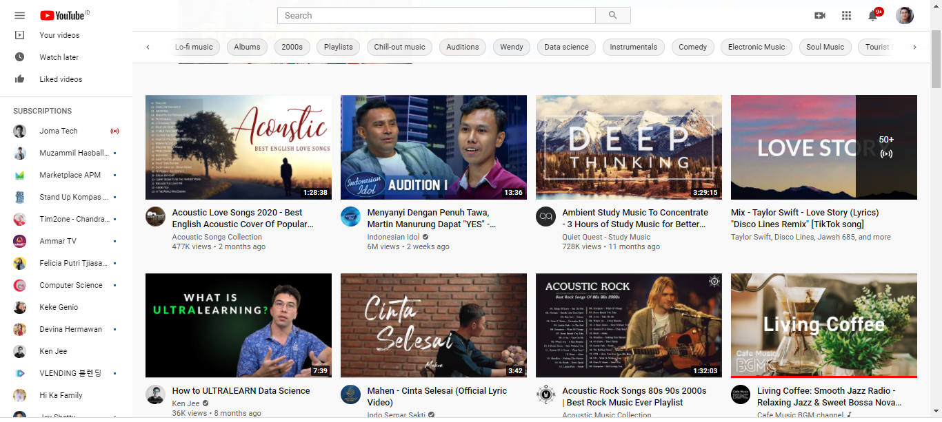
Recommender System Around Us

Slide 8
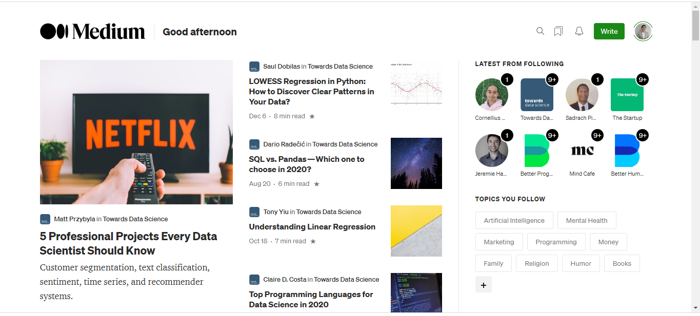
Recommender System Around Us

Slide 9
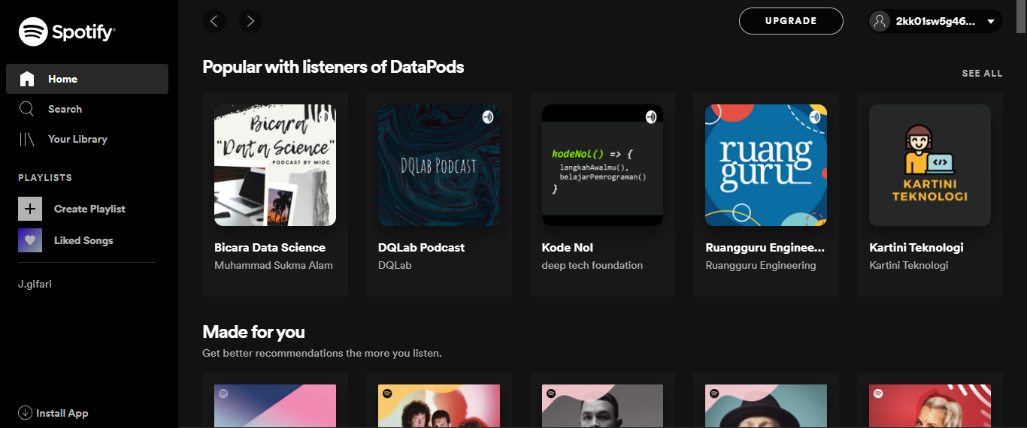
Recommender System Around Us

Slide 10
Case Study

Slide 11
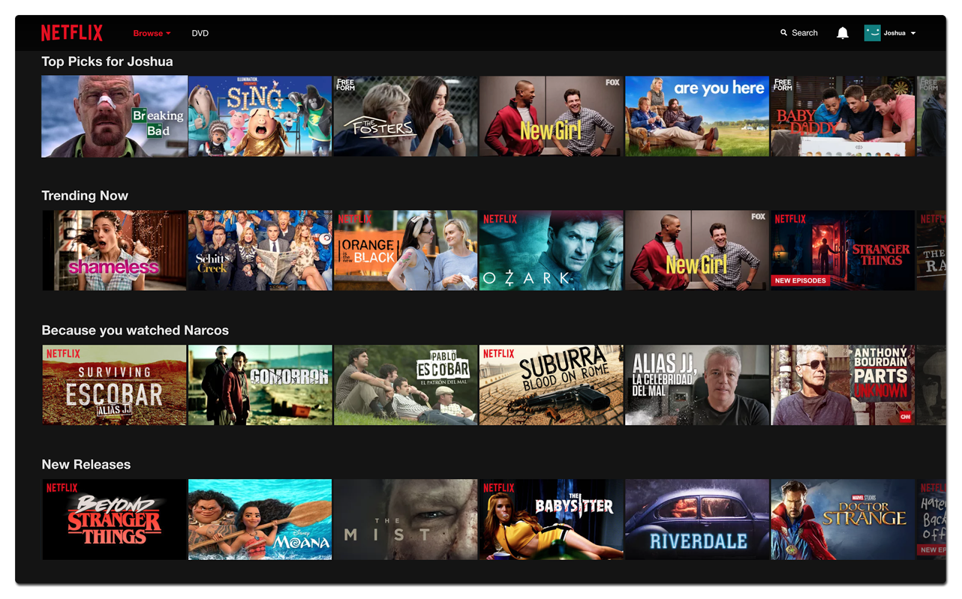
Recommender System in Netflix

Slide 12
Different Types of Recommender System
Simple recommenders: offer generalized recommendations to every user, based on movie popularity and/or genre. The basic idea behind this system is that movies that are more popular and critically acclaimed will have a higher probability of being liked by the average audience. An example could be IMDB Top 250.

Slide 13
Different Types of Recommender System
Content-based recommenders: suggest similar items based on a particular item. This system uses item metadata, such as genre, director, description, actors, etc. for movies, to make these recommendations. The general idea behind these recommender systems is that if a person likes a particular item, he or she will also like an item that is similar to it. And to recommend that, it will make use of the user's past item metadata. Another example could be YouTube, where based on your history, it suggests you new videos that you could potentially watch.

Slide 14
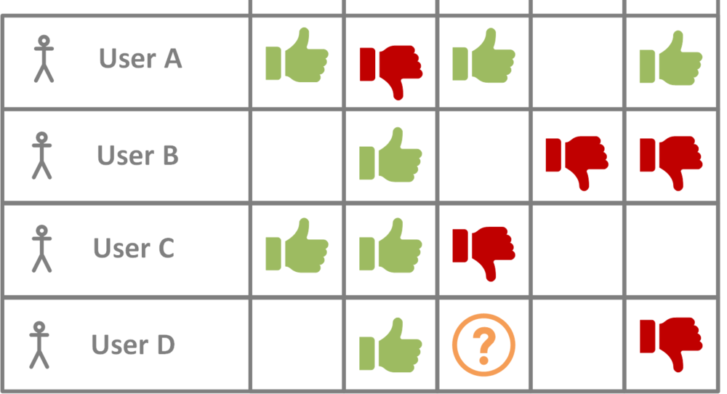
Different Types of Recommender System
Collaborative filtering engines: these systems are widely used, and they try to predict the rating or preference that a user would give an item-based on past ratings and preferences of other users. Collaborative filters do not require item metadata like its content-based counterparts.
Movie1 Movie2 Movie3 Movie4 Movie5

Slide 15

Different Types of Recommender System

Slide 16
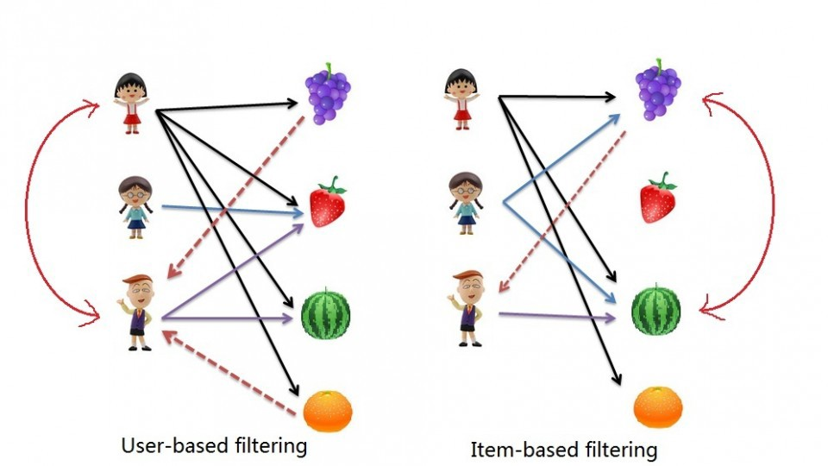
Collaborative Filtering

Slide 17
Let’s Find out how to create recommender system in Python!

Slide 18
Thank You

